Slide 1
CROP PRODUCTION IN INDIA
1997-2015

Slide 2
ABOUT
Delving into the vast and dynamic realm of Agriculture, my analysis spans several years and covers a wealth of data on crop production. 📈
Agriculture analysis involves the examination of various factors related to the cultivation of crops, livestock management, and overall agricultural practices.
This analysis is crucial for optimizing productivity, ensuring food security, and making informed decisions for sustainable agricultural development.
Agriculture analysis is an interdisciplinary field that incorporates data science, technology, agronomy, economics, and environmental science to support efficient and sustainable farming practices.
It plays a crucial role in addressing global food security challenges and promoting the responsible use of natural resources in agriculture.

Slide 3
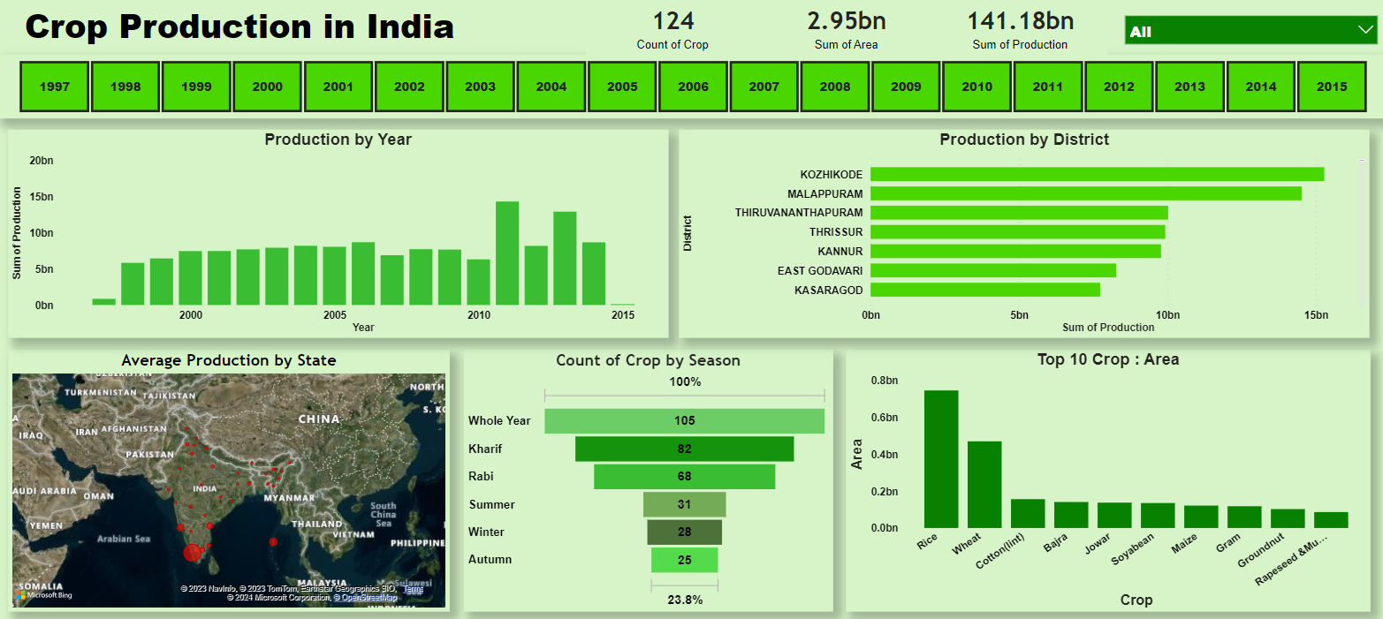

Slide 4
KEY INSIGHTS
Year 2015 has maximum production about 15bn.
Rice and wheat are indeed two of the most important and widely cultivated cereal crops globally.
The cultivation of cereal crops like rice, bajra (pearl millet), wheat, and others varies based on the climate and growing conditions in different regions. These crops are often classified into two main categories: summer or kharif crops and winter or rabi crops.
Summer or Kharif Crops:
Rice (Paddy): Rice is a major kharif crop and is typically cultivated in areas with high rainfall and warm temperatures. It requires flooded fields for cultivation.
Bajra (Pearl Millet): Bajra is well-suited to arid and semi-arid regions and is often grown as a kharif crop. It is known for its tolerance to high temperatures and low rainfall.
Maize (Corn): Maize is another kharif crop that is grown in warmer regions. It is versatile and can be cultivated in a range of climates.
Sorghum (Jowar): Sorghum is a kharif crop that is drought-tolerant and can thrive in areas with limited water availability.

